Slide 1
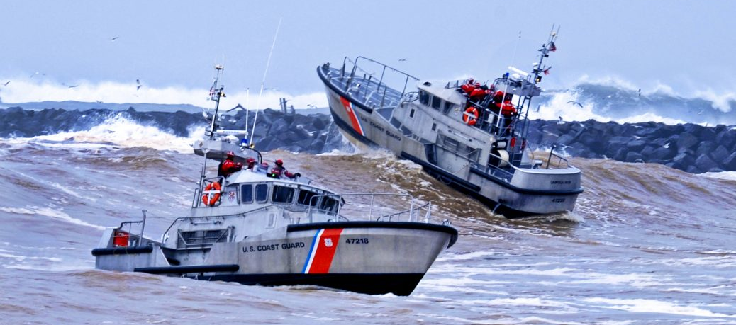
Emotional Intelligence (EQ)
Notes:
Emotional Intelligence (EQ)

Slide 2
Learning Objectives
Coast Guard Operational
Stress Control (CG -0SC )
DEFINE and DISCUSS Emotional Intelligence (EQ)
IDENTIFY the benefits of EQ
IDENTIFY and DISCUSS the components of EQ
EXPLAIN the importance of improving your EQ
Notes:
Learning Objectives
Upon completion of this training, participants will be able to:
DEFINE and DISCUSS Emotional Intelligence (EQ)
IDENTIFY the benefits of EQ
IDENTIFY and DISCUSS the components of EQ
EXPLAIN the importance of improving your EQ

Slide 3
Emotional Intelligence (EQ)
Coast Guard Operational
Stress Control (CG -0SC )
The ability to recognize, understand and manage our own emotions (that drive our behaviors), and impact others (positively and negatively); and the ability to recognize, understand and influence the emotions of others.
Good, fundamental leadership starts with self-awareness and self-confidence - having an honest understanding of your own emotions, strengths, weaknesses, needs and drives, and recognizing how your feelings affect you and others, and your job performance.
Notes:
Emotional Intelligence (EQ):
Discussion Questions:
-What are important elements of leadership?
Emotional Intelligence (EQ) is the ability to understand and manage your own emotions (that drive our behaviors) and impact others (positively and negatively); and the ability to recognize, understand and influence the emotion of others, and those of the people around you.
Leadership involves a coach-mentor process and the ability to influence individuals using components of emotional intelligence. Components of emotional intelligence are invaluable traits that support leadership and effective followership.
People with a high degree of emotional intelligence know what they're feeling, what their emotions mean, and how these emotions can affect other people.
Qualities traditionally associated with leadership such as intelligence, toughness, decisiveness, determination and vision are required for success, but they are not enough.
Good, fundamental leadership starts with self-awareness and self-confidence - having an honest understanding of your own emotions, strengths, weaknesses, needs and drives, and recognizing how your feelings affect you and others, and your job performance.

Slide 4
Benefits of EQ
Coast Guard Operational
Stress Control (CG -0SC )
Improve communication Better management of stressful or frustrating situations Better handling of failures and disappointing situations Better understand diversity and cultural sensitivities | Support unit cohesion & decrease work conflict Improve problem solving skills Better manage the emotions of individuals of different ages
Notes:
Benefits of EQ:
Benefits of Emotional Intelligence:
Improved communication
Better management of stressful or frustrating situations
Better handling of failures and disappointing situations
Supports unit cohesion and decreases workplace conflict
Improves problem solving skills
Helps to manage the emotions of people of different ages
Helps to better understand diversity and cultural sensitivities

Slide 5
Coast Guard Operational
Stress Control (CG -0SC )
Components of EQ
Self-Awareness | Self-Regulation | Motivation | Empathy | Social Skills
The ability to recognize and understand your moods, emotions, and drives, as well as their effect on others | The ability to control or redirect disruptive impulses and moods; to think before speaking and acting | Being driven to achieve for the sake of achievement. A passion beyond money or status; to pursue goals with energy and persistence | The ability to understand the emotional makeup of other people; Considering others’ feeling, especially when making decisions | Proficiency in managing relationships and building networks; an ability to find common ground and build rapport
Self-confidence Awareness of your strengths as well as weaknesses Realistic self-assessment Self-deprecating sense of humor | Trustworthiness and integrity Comfort with ambiguity Openness to change Remaining calm in every situation | Leading by example Strong drive to achieve Optimism even in the face of failure Organizational Commitment | Expertise in building and retaining talent Cross-cultural sensitivity Service to others Ability to develop others | Effectiveness in leading change Persuasiveness Expertise in building and leading teams
Notes:
Components of EQ:
Instructor Note:
Discuss the five elements then ask:
Discussion Questions:
-How will enhancing your skills around these components of EQ benefit you as a leader?
Truly effective leaders are also distinguished by a high degree of emotional intelligence, which includes: the five(5) elements of Emotional Intelligence: self-awareness, self-regulation, motivation, empathy and social skills
Self-awareness is the ability to recognize and understand your moods, emotions, and drives, as well as their effect on others. When you are self-aware, you see yourself as others see you, and have a good sense of your own abilities and current limitations.
Self-confidence: Is trusting in one's abilities, qualities and judgments
Building self-confidence requires taking care of yourself, being active, being prepared, helping others, studying and achieving goals, positive thinking, living by values, and being grateful
Realistic self-assessment: requires identifying your inner resources; abilities and strengths; acknowledging and accepting your limits; being open to feedback about yourself; desires for continuous learning and self improvement
Self-deprecating sense of humor: laugh at yourself, admit shortcomings with a smile
Self-Regulation (managing emotions) is the ability to control or redirect disruptive impulses and moods; to think before acting. Being able to manage your own emotional state is essential for taking responsibility for your actions, and can save you from hasty decisions that you later regret
Trustworthiness and integrity
Comfort with ambiguity (vagueness, lack of clarity and uncertainty): Coping with changes, being able to make decisions without the whole picture, taking risks, and being clear on what you do know.
Openness to change
Motivation is the passion to work for reasons that go beyond money or status; a propensity to pursue goals with energy and persistence. It is using your deepest emotions to move and guide you towards your goals. This ability enables you to take the initiative and to persevere in the face of obstacles and setbacks.
Strong drive to achieve
Optimism, even in the face of failure
Organizational commitment
Empathy is the ability to understand the emotional makeup of other people; consider other’s feelings, especially when making decisions; skills in treating people accordingly to their emotional reactions. Self-awareness is essential to having empathy with others. If you are not aware of your own emotions, you will not be able to read the emotions of others.
Expertise in building and retaining talent
Cross-cultural sensitivity
Service to others
Social Skills is having a proficiency in managing relationships and building networks; an ability to find common ground and build rapport. Being able to handle emotions in relationships and being able to influence and inspire others are essential foundation skills for successful teamwork and leadership.
Effectiveness in leading change
Persuasiveness
Expertise in building and leading teams

Slide 6
Coast Guard Operational
Stress Control (CG -0SC )
Improving Your EQ
Self-Awareness | Self-Regulation | Motivation | Empathy | Social Skills
“Tune in” to your emotions Keep a journal Slow down Practice mindfulness | Know your values Hold yourself accountable Practice being calm Flexibility Practice gratitude | Remember why you joined the CG Be hopeful and find something good, practice optimism | Put yourself in someone else's position Pay attention to body language Respond to feelings | Learn conflict resolution Improve your communication skills Learn how to praise
Notes:
Improving Emotional Intelligence
Today’s technical demands are increasing. However, there is a corresponding need for the uniquely human ability to work with and through others to accomplish goals. Emotional Intelligence is critical in building and maintaining relationships that influence others. EQ can be learned, developed, and enhanced. The following are ways one can improve their EQ:
Self-Awareness: If you're self-aware, you always know how you feel, and you know how your emotions and your actions can affect the people around you. Being self-aware when you're in a leadership position also means having a clear picture of your strength and weaknesses, and it means behaving with humility.
Improve your self-awareness:
Keep a journal: Journals help you improve your self-awareness. If you spend just a few minutes each day writing down your thoughts, this can move you to a higher degree of self-awareness.
Slow down: When you experience anger or other strong emotions, slow down to examine why. Remember, no matter what the situation, you can always choose how you react to it.
Practice mindfulness: Mindfulness allows you to be present with yourself and observe your thoughts in a non-judgmental way.
Self-Regulation: Individuals who regulate themselves effectively rarely verbally attack others, make rushed or emotional decisions, stereotype people, or compromise their values. Self-regulation is all about staying in control. This element of emotional intelligence, also covers a leader's flexibility and commitment to personal accountability.
Improve your ability to self-regulate:
Know your values: Have a clear idea of where you absolutely will not compromise. Know what values are most important to you. Spend some time examining your values.
Hold yourself accountable: Take responsibility for your actions. Admit to your mistakes and face the consequences.
Practice being calm: Respond instead of react. Practice deep-breathing exercises to calm yourself. Write down all of the negative things you want to say, and then rip it up and throw it away. Expressing these emotions on paper is better than speaking them out loud. This helps you challenge your reactions to ensure they are appropriate.
Flexibility: Willingness to change or compromise
Practice gratitude: Give "Thank you's", thankfulness, positive self-talk, smile, acts of kindness, volunteer
Motivation: Self-motivated leaders work consistently toward their goals, and they have extremely high standards for the quality of their work.
Improve your motivation:
Re-examine why you're doing your job: Why did you join the CG? It's easy to forget what you really love about your career. So, take some time to remember why you wanted this job. Develop goals statements and make sure that your goal statements are fresh and energizing.
Know where you stand: Determine how motivated you are to lead.
Be hopeful and find something good: Practice optimism, no matter what problems they face. Adopting an optimistic mindset might take practice, but it’s well worth the effort. Every time you face a challenge, or even a failure, try to find at least one good thing about the situation. It might be something small, or something with long-term effects, like an important lesson learned. But there's almost always something positive, if you look for it.
Empathy: For leaders, having empathy is critical to managing a successful team or organization. Leaders with empathy have the ability to put themselves in someone else's situation. They help develop the people on their team, challenge others who are acting unfairly, give constructive feedback, and listen to those who need it. If you want to earn the respect and loyalty of your team, then show them you care by being empathic. Empathy is an immensely helpful skill for every individual as it aids in responding appropriately to a situation and promotes a more helpful behavior.
Improving your empathy:
Put yourself in someone else's position – It's easy to support your own point of view. After all, it's yours! But take the time to look at situations from other people's perspectives.
Pay attention to body language – Perhaps when you listen to someone, you cross your arms, move your feet back and forth, or bite your lip. This body language tells others how you really feel about a situation, and the message you're giving isn't positive! Learning to read body language can be a real asset in a leadership role, because you'll be better able to determine how someone truly feels. This gives you the opportunity to respond appropriately.
Respond to feelings – You ask your Sailors to work late – again. And although they acknowledge, you can hear the disappointment in his voice. So, respond by addressing their feelings. Tell them you appreciate how willing they are to work extra hours, and that you understand their frustrations about working late. If possible, figure out a way for less future late nights or plan for compensation and share your plans with your Sailor.
Social Skills: Leaders and individuals who do well in the social skills element of emotional intelligence are great communicators. They're just as open to hearing bad news as good news, and they're expert at getting others to support them and be excited about a new mission or project. Individuals who have good social skills are also good at managing change and resolving conflicts diplomatically. They're rarely satisfied with leaving things as they are, but they don't sit back and make everyone else do the work: they set an example with their own behavior.
Improving Social Skills:
Learn conflict resolution: Leaders must know how to resolve conflicts between their unit members. Learning conflict resolution skills is vital if you want to succeed. Requires empathy, calm, non-defensive and respectful engagement, compromise, respect differences.
Improve your communication skills: How well do you communicate? Active listening, being concise, speaking clearly, do not attack, be honest, check your body language
Learn how to praise others: As a leader, you can inspire the loyalty of your team simply by giving praise when it's earned.

Slide 7
Exercise: Emotional Intelligence
Coast Guard Operational
Stress Control (CG -0SC )
Notes:
Exercise: Emotional Intelligence Questionnaire
This self-assessment questionnaire is designed to get you thinking about the various competences of emotional intelligence as they apply to you.
Directions:
Fill out the Emotional Intelligence Questionnaire. – ensure students have plenty of time to complete the questionnaire.
1. Assess and Score each questionnaire's statement
2. Total and interpret your results
3. Consider your results and identify one or two actions you can take immediately to strengthen your emotional intelligence
Time Allotted: 20 minutes
Discussion Questions:
-Did you find out anything new about yourself? If so, what was it?
-Were you surprised at your rating outcomes for the 5 areas – self-awareness, managing emotions, motivating oneself, empathy and social skill?
-If you asked someone close to you to rate you in these 5 categories, how do think they would rate you?
-Do you think you are an effective leader? If so, how come?
https://www.londonleadershipacademy.nhs.uk/sites/default/files/Emotional_intelligence_questionnaire-LAL1.pdf

